Slide 1
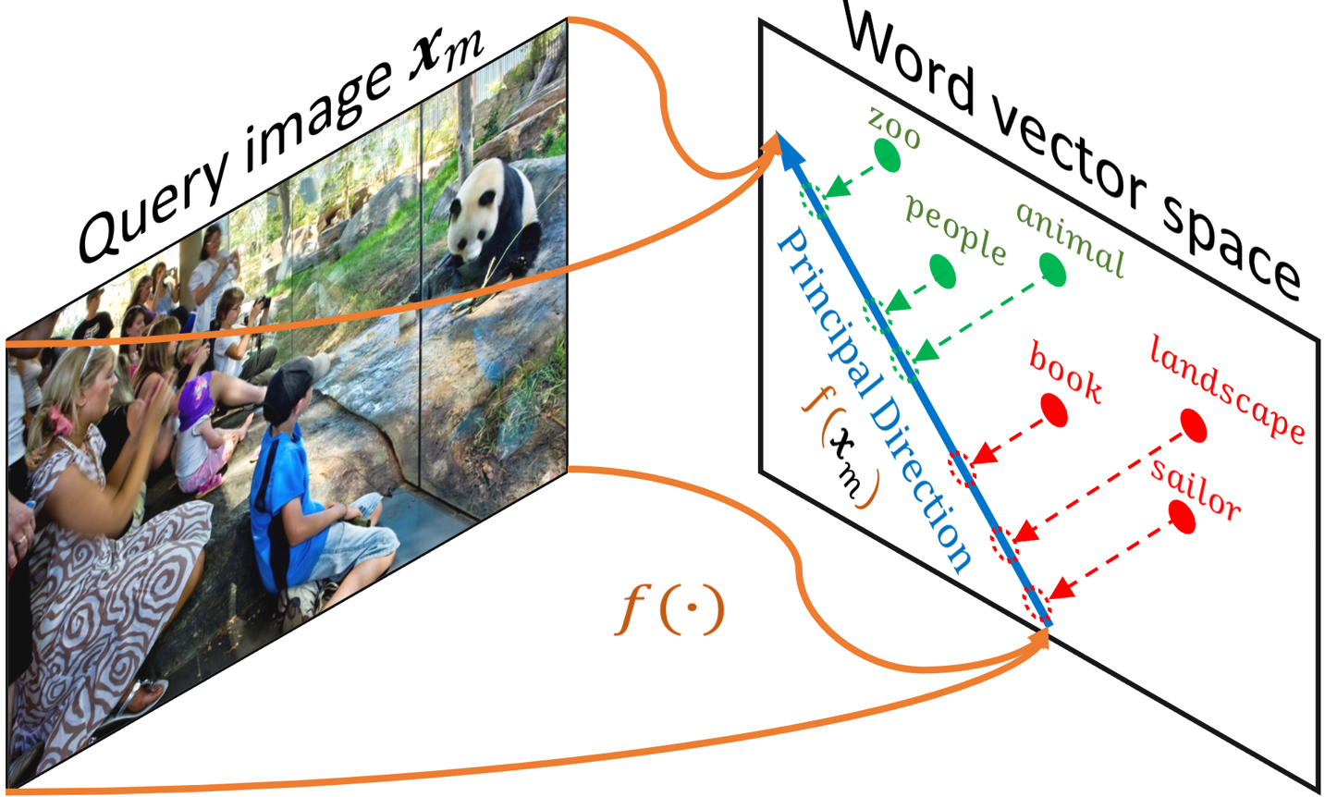
Fast zero shot learning

Slide 2
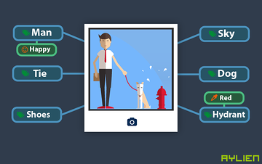
Image tagging and problem
All the tag are given in training phase
How to tag image which it’s tag is not given in training phase
Zero shot learning

Slide 3
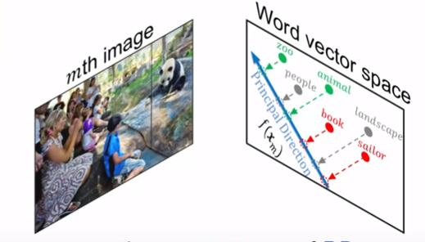
Zero shot learning
Find the Principal Direction between Image and Word vector space
Project unseen tags to this Principal Direction

Slide 4

Principal Direction using Deep Learning
f (.)
Dense Linear
2048 D
300 D
Dot
Y_predict
Dense Relu
Dropout 30%
300 x 291 D
8096 D
Word Embedding
Dense Relu
4096 D
Tags
Pre-trained CNN

